Slide 1
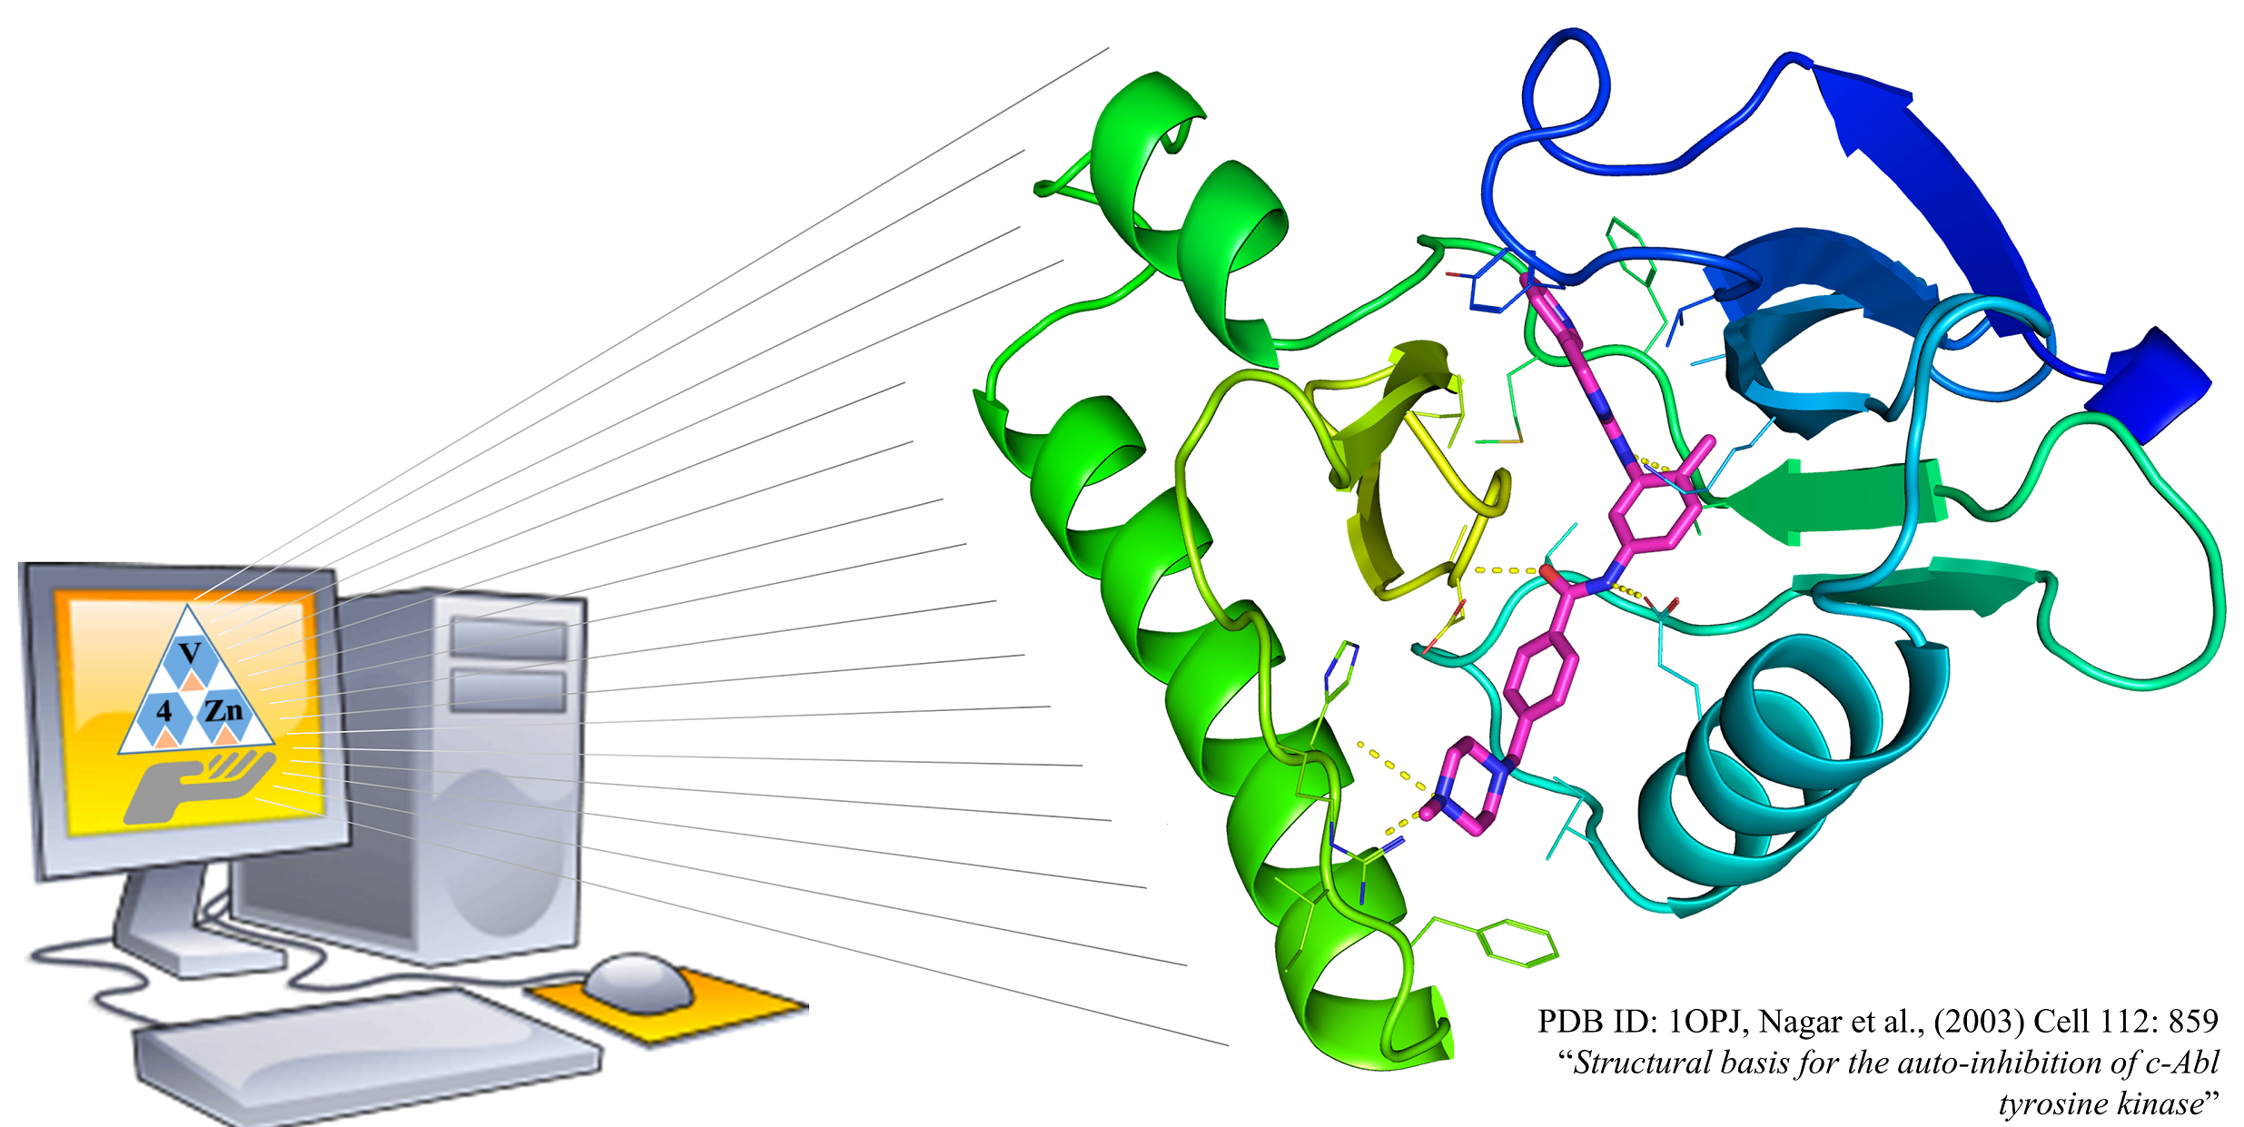
AMDock
Assisted Molecular Docking with
AutoDock Vina and AutoDock4
USER MANUAL

Slide 2
Figure 1. Workflow in AMDock

Slide 3
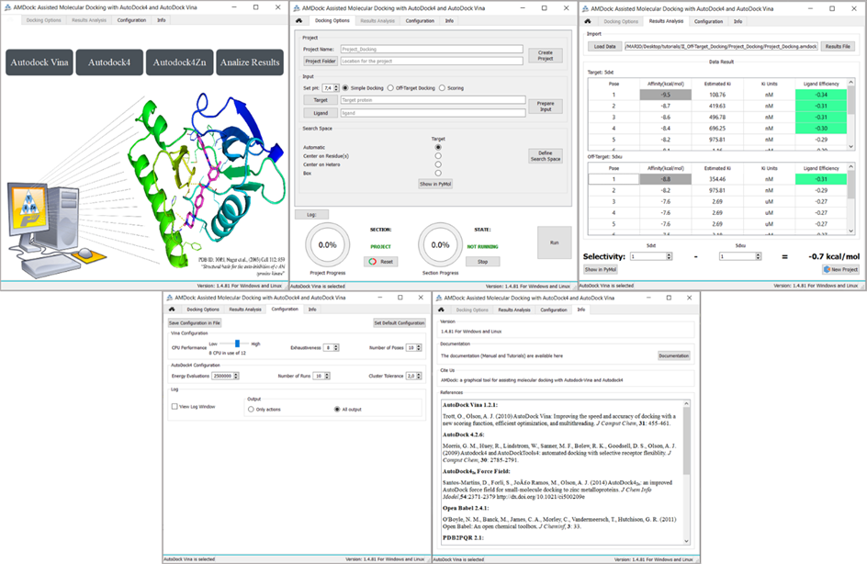
Figure 2. AMDock components. From left to right: Home, Docking Options, Results Analysis, Configuration and Info.

Slide 4
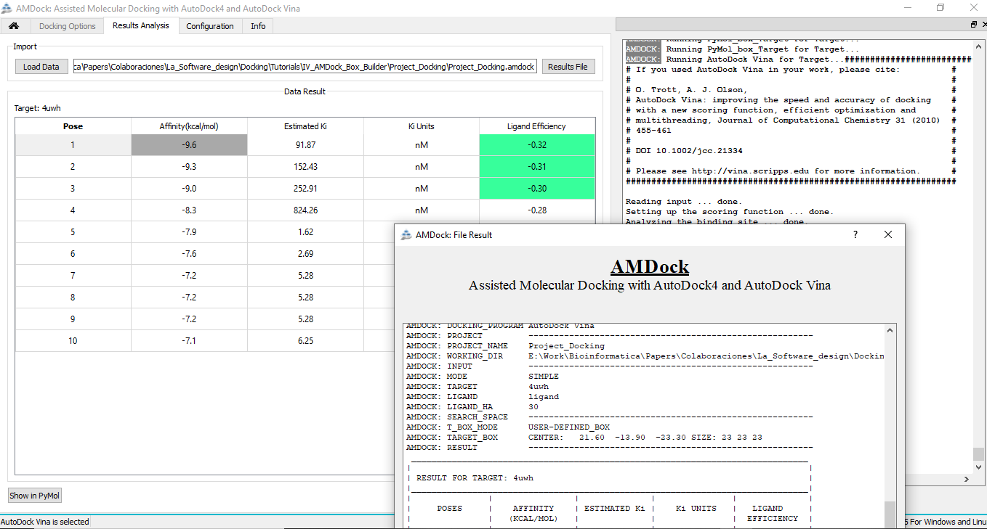
Figure 3. AMDock Result Analysis Tab. Behind left to right: Result table and Log record. The AMDock output table is shown in the front.

Slide 5
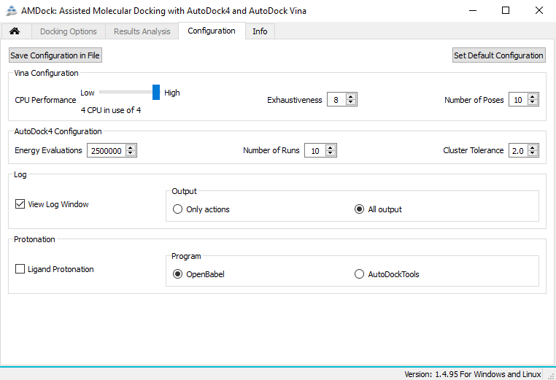
Figure 4. AMDock Configuration Tab.

Slide 6
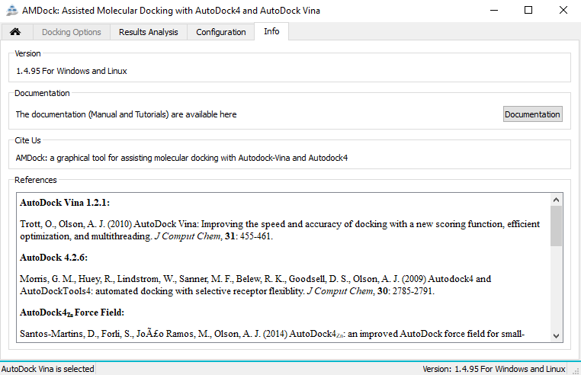
Figure 5. AMDock Info Tab.

Slide 7
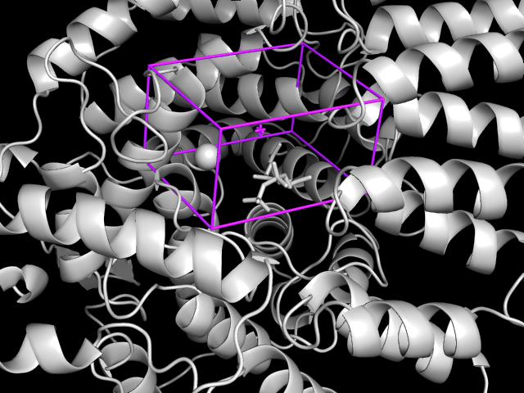
Figure 6. Custom Box. The protein (farnesyltransferase) is represented in cartoon and gray color. Note that the Zn atom and the cofactor are also represented, in sphere and sticks respectively. The box is shown in cylinders and magenta color.

Slide 8
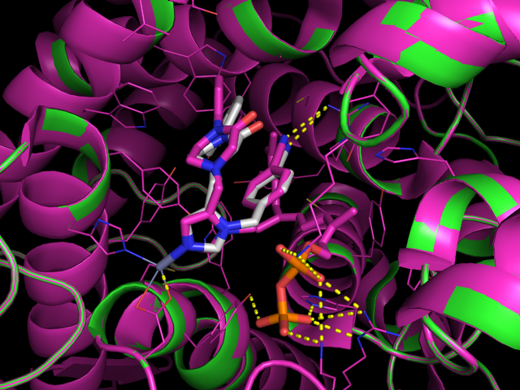
Figure 7. Superposition of the predicted complex from custom box using AutoDock4Zn with a reference complex (PDB ID: 1S63). Receptor is represented as cartoon while X-ray and predicted ligand binding pose are repreented as white and magenta sticks respectively.

Slide 9
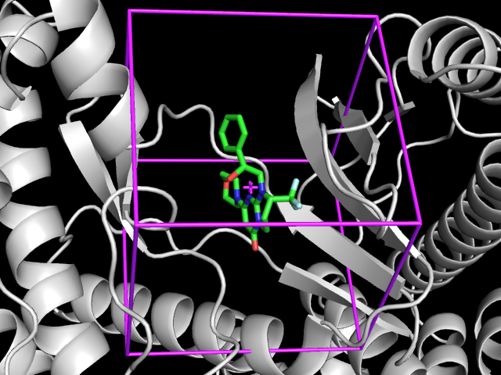
Figure 8. Box Centered on Hetero. The protein (Vps34) is represented in cartoon and gray color and previous ligand in green sticks. The box is shown in cylinders and magenta color.

Slide 10
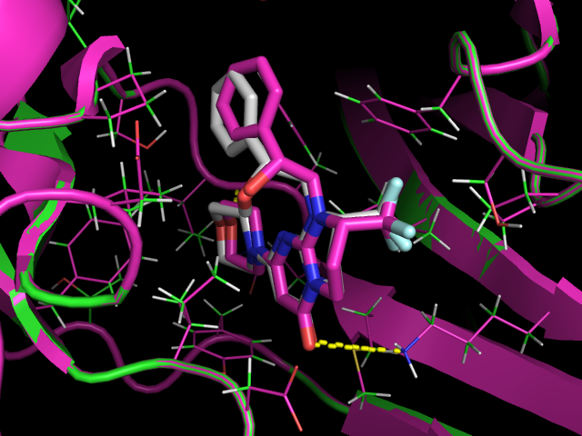
Figure 9. Superposition of predicted complex from box Centered on Hetero with a reference complex (PDB ID: 4UWH). Receptor is represented as cartoon while X-ray and predicted ligand binding pose are repreented as white and magenta sticks respectively.

Slide 11
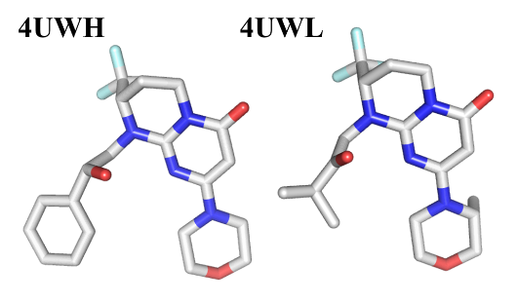
Figure 10. Vps34 inhibitors with similar structure.

Slide 12
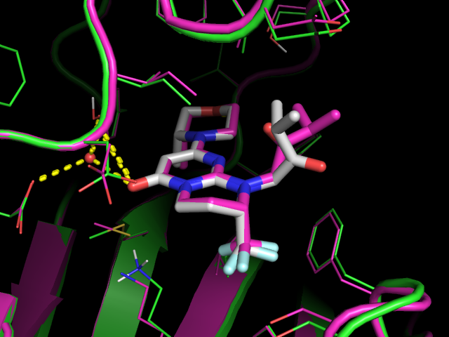
Figure 11. Superposition of predicted complex from box Centered on Hetero with a reference complex (PDB ID: 4UWL). Receptor is represented as cartoon while X-ray and predicted ligand binding pose are repreented as white and magenta sticks respectively.

Slide 13
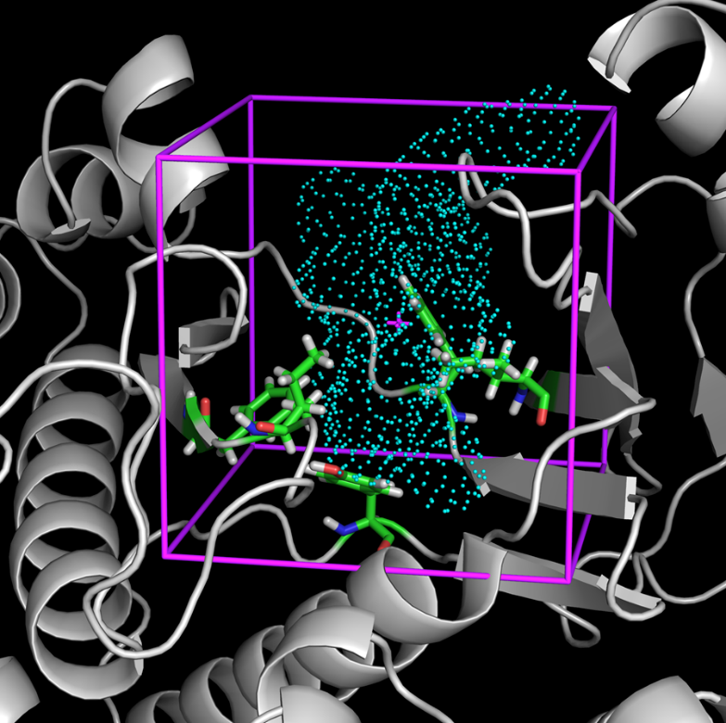
Figure 12. Box Centered on Residues. The protein (Vps34) is represented in gray cartoon, the selected residues in green sticks and the object generated by AutoLigand in cyan dots. The box is shown in magenta cylinders

Slide 14
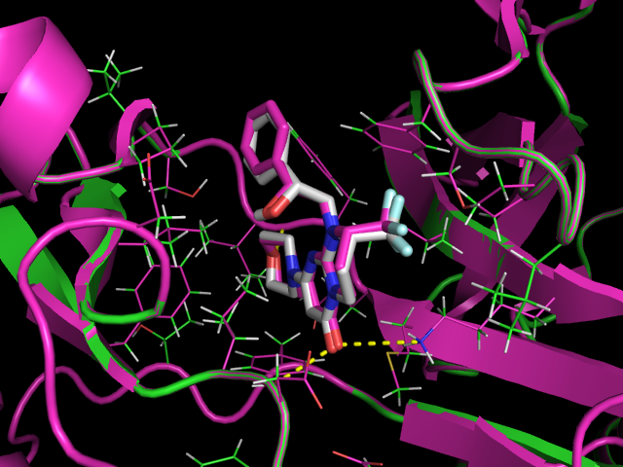
Figure 13. Superpsition of predicted complex from box Centered on Residue(s) with a reference complex (PDB ID: 4UWH). Receptor is represented as cartoon while X-ray and predicted ligand binding pose are repreented as white and magenta sticks respectively.

Slide 15
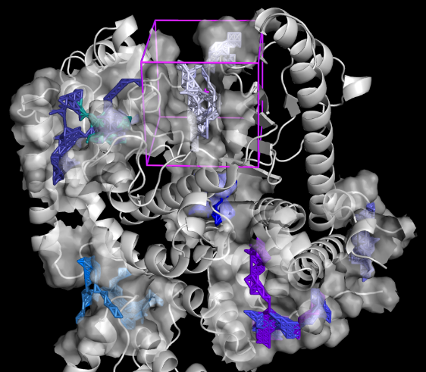
Figure 14. Automatic mode Search Space determination. The protein (Vps34) is represented gray cartoon. Each binding site predicted by AutoLigand is repsented as transparent surface and also contains an object represented as sticks. The box is shown in cylinders and magenta color. Only one box is shown for better clarity.

Slide 16
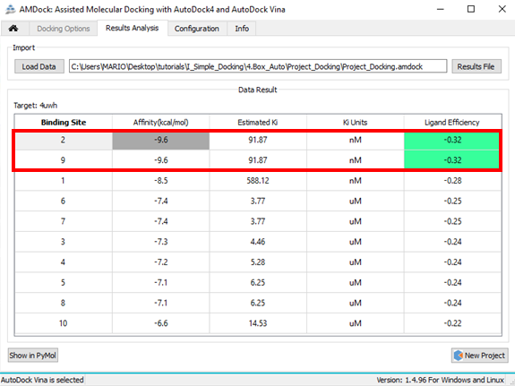
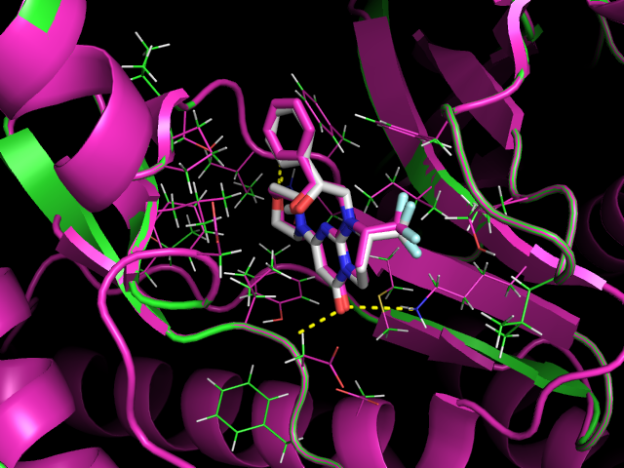
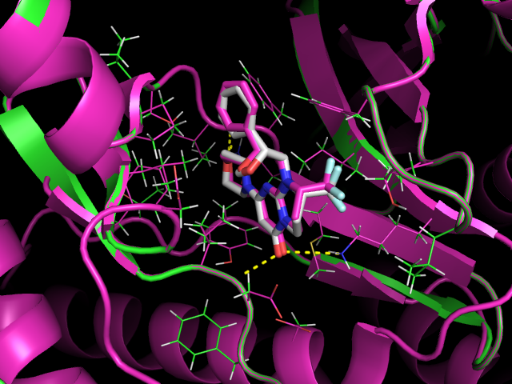
Figure 15. Results from Automatic mode selection. Up: The table show the sorted list of affinity for each predicted binding site. Down: Superpsition of predicted complex from predicted site 2 (left) and 9 (rigth) with a reference complex (PDB ID: 4UWH). Receptor is represented as cartoon (green) while X-ray and predicted ligand binding pose are represented as white and magenta sticks respectively.

